Slide 1
BIZ06 – Bahasa Inggris 2

Slide 2
UNIT 3 Products and services
Meeting 4-5

Slide 3
Specific Competence
Students are able to apply the past simple and the passive, and describe products and services (C3)

Slide 4
1. Past Simple

Slide 5
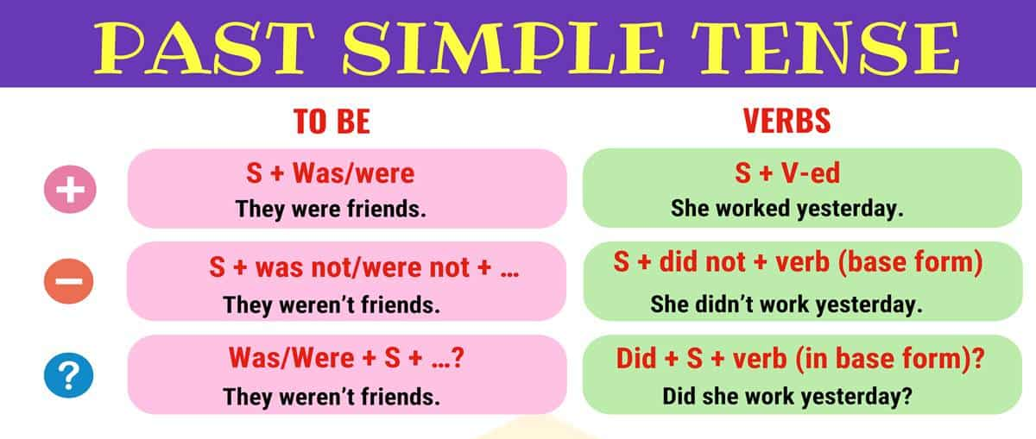
1.1 Forms
The simple past tense shows that you are talking about something that has already happened. It emphasizes that the action is finished.

Slide 6
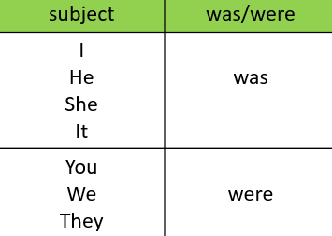
Example of was/were
1.2 Usages
The view was so beautiful.
I was happy on my last holiday.
They weren’t angry when I came late.
My friends and I were excited.
Were you a teacher?
I was English student at UBM.

Slide 7
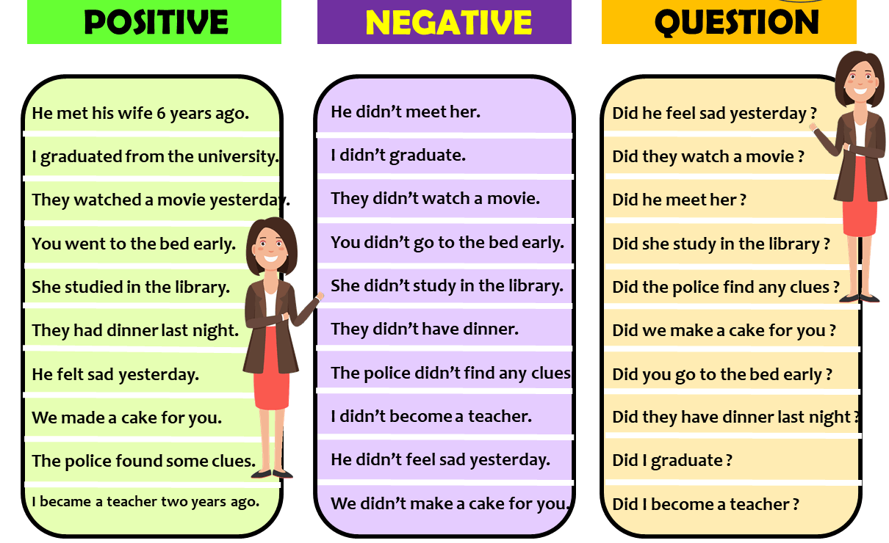
1.2 Usages

Slide 8
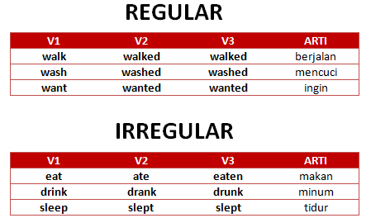
There are two kinds of verbs.
1.3 Kinds of verbs
Irregular verb list: https://speakspeak.com/resources/vocabulary-general-english/english-irregular-verbs

Slide 9
Negative sentence in simple past tense.
1.4 Negative form
The party was fantastic. Every guest brought something to eat and a bottle of wine.
The party wasn’t fantastic. Every guest didn’t bring something to eat and a bottle of wine.
Shakespeare wrote a lot of plays.
➔ Shakespeare didn’t write a lot of plays.

Slide 10
Questions in simple past tense.
1.5 Question form
Did you go to work yesterday?
Did they arrive on time?
Did she like the surprise?
Where did she go?
What did you do yesterday?
What did you say? - I didn't say anything.
Why did we have to come?

Slide 11
Practice 1
Part I. Regular (R) or Irregular verbs (I)?
Watch → _____.
Study → _____.
Read → _____.
Begin → _____.
Fly → _____.
Win → _____.
Play → _____.
Write → _____.
Open → _____.
Tear → _____.

Slide 12
Practice 1
Part II. Fill in the blanks with “was” or “were”.
I ____ in Canberra last spring.
We ____ at school last Saturday.
Tina ____ at home yesterday.
He ____ happy.
Robert and Stan ____ Garry's friends.
You ____ very busy on Friday.
They ____ in front of the supermarket.
I ____ in the museum.
She ____ in South Africa last month.
Jessica and Kimberly ____ late for school.
was
were
was
was
were
were
were
was
was
were

Slide 13
Practice 1
Part III. Put one of these verbs in each sentence
eat bring write buy see meet
The party was fantastic. Every guest __________ something to eat and a bottle of wine.
I had an extravagant weekend. I __________ some clothes and a plant.
Three weeks ago Tracy __________ her ex-husband in Mallorca. What a coincidence!
When I lived in Italy, we always __________ lamb at Easter.
Shakespeare _______________ a lot of plays.

Slide 14
Practice 1
Part IV. Put the verb in the past simple.
Tom _______________ (not/come) to the office yesterday because he _______________ (be) ill.
She _______________ (not/read) the book because she _______________ (not/be) very interested in that author.
The students _______________ (not/finish) their group project because they _______________ (run out) of time.
We _______________ (not/eat) anything for breakfast because we _______________ (be) in a hurry.
Mary _______________ (not/catch) the train to Mexico City because she _______________ (arrive) at the station too late.
didn’t come
was
didn’t read
wasn’t
didn’t finish
ran out
didn’t eat
were
didn’t catch
arrived

Slide 15
2. The passive

Slide 16
2.1 Form
The passive of an active tense is formed by putting the verb to be into the same tense as the active verb and adding the past participle of the active verb.
Active: My grandfather planted this tree.
Passive: This tree was planted by my grandfather.

Slide 17
2.1 Usages
We use the passive when:
We know/don’t know who does something:
The bicycle was invented 200 years ago.
It is important/not important to say who does something:
Spanish is spoken in many South American countries
If we want to say who does something, we use by:
Mandarin Chinese is spoken by over a billion people.
The reports were written by my colleagues.

Slide 18
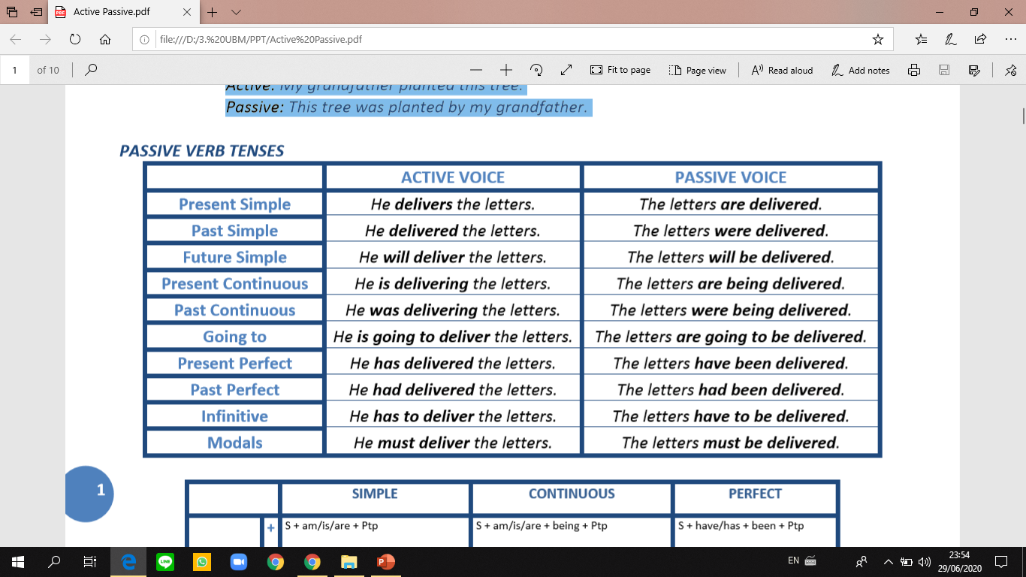
2.1 Usages

Slide 19
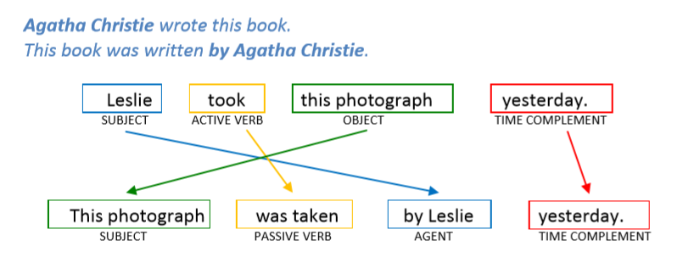
Pay attention to this example.
2.1 The Passive

Slide 20
Practice 2
Change the active sentences into passive ones.
Open page 21 to answer questions in part G.

Slide 21
3. Adjectives to describe products and services

Slide 22
1.1 Grammar Presentation
Don’t mix up –ed and –ing:
I am interested in your courses.
(a person is interested.)
Your courses is very interesting.
(a thing is interesting.)

Slide 23
Practice 3
Part I. Find the different meaning between the adjectives, and make sentences.
amazing – amazed
boring- bored
disappointing – disappointed
exciting – excited
surprising – surprised

Slide 24
4. Vocabulary

Slide 25
4.1 Vocabulary Bank
Check the meaning of these words in a dictionary.
Trade show
Feature
Native speaker
To depend (on)
To guess
Complicated
Device
Model
Display

Slide 26
Practice 4
Choose the best word from previous slide to complete the sentences.
The words are shown on the ____ or spoken out load.
The Lingua Traveler has lots of special ____.
You must respect the ____ and ____ of other cultures.
You’ll never ____ how much I paid for this phone.
The store sells at kinds of electronic ____.
There are about 360 million ____ ____ of English in the world.
I cant understand your explanation. It’s too ____.
Lisa Yang worked at a ____ ____ in Taipei.

Slide 27
5. Listening Activity

Slide 28

Practice 5
Play the audio file track 11 to answer the questions on page 22.
Play the audio file track 12 to answer the questions on page 24

